Slide 1
A Quick Look at Metamarkets’ Druid
Jay Wang
CS 394: Research Independent Study
21 March 2013

Slide 2
Background
“Druid is the distributed, in-memory OLAP data store” Metamarkets built to serve their ad analytics needs
“Keeping everything in memory provides fast scans, but it does introduce a new problem: machine memory is limited.” – Metamarkets
Solution: distribute data over multiple machines

Slide 3
Requirements
The initial requirements for Druid were:
(1) ability to load up, store, and query data sets in memory
(2) parallelized architecture to allow more machines
(3) parallelized queries to speed full scan processing
(4) no dimensional tables to manage

Slide 4
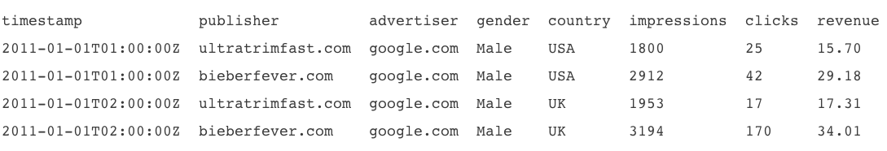
Architecture
Druid stores beta data, a more potent and compressed version of alpha data (raw, un-aggregated event logs), in memory
Sample beta data set:

Slide 5
Realtime Ingestion
Realtime Ingestion is done through Historical and Realtime nodes
Both nodes have data for a time period they are responsible for (i.e. one hour)
For example, a Realtime node would have data for one hour and that hour includes right now
On some time bound, the Realtime nodes will push their data segments to the Historical nodes

Slide 6
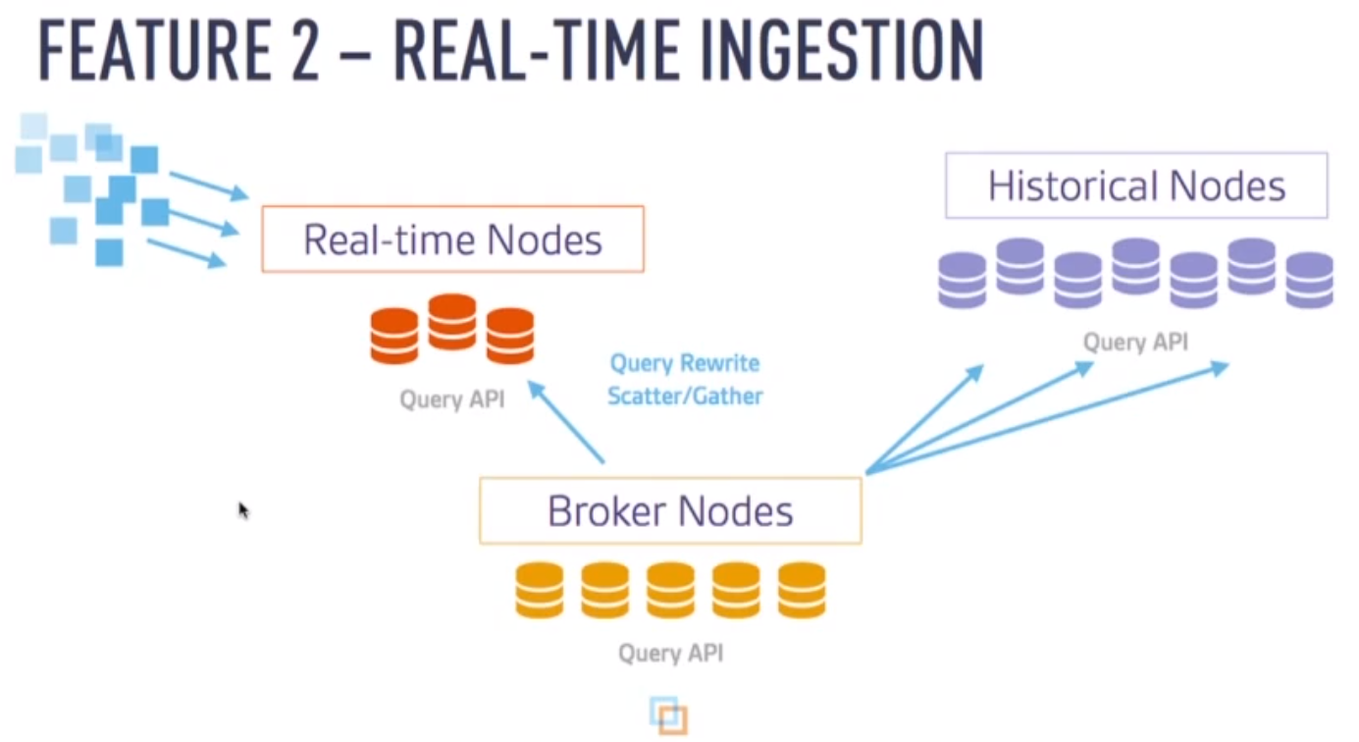
Diagram

Slide 7
Node Types
Compute nodes are the workhorses that handle storage and querying on historical data
Realtime nodes ingest data in real-time and focus on making the stream of incoming data immediately queryable by the system
Master nodes serve as the main coordinators, making sure that data is available, replicated, and in an “optimal” configuration
Broker nodes understand the data layout across all of the other nodes in the cluster and re-write and route queries accordingly
Indexer nodes load batch and real-time data into the system as well as allow for alterations to the data stored in the system (as of Nov 2012, these nodes are still a work in progress. Realtime and HadoopDruidIndexer are the two entities handling indexing right now)

Slide 8
Competing Products
Druid sits between PowerDrill and Dremel on the spectrum of functionality
Druid can do almost anything Dremel does (except that Dremel handles arbitrary nested structures whereas Druid only allows for single level of array nesting)
Druid utilizes some data layout and compression methods from PowerDrill

Slide 9
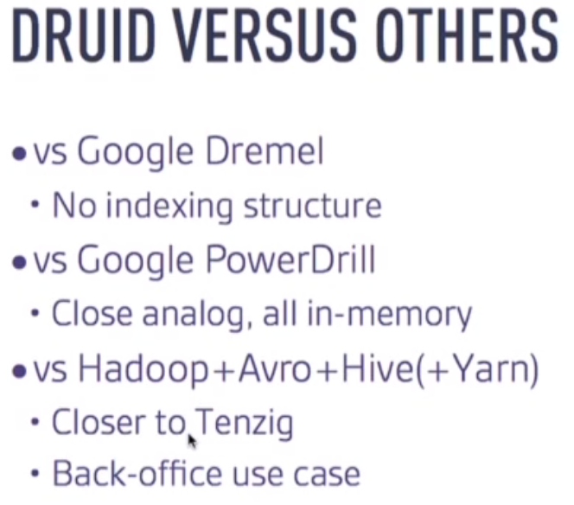
Diagram

Slide 10
Use Cases
Druid is ideal for products that require real-time ingestion of a single, large data stream
Also a good fit if you are dealing with a no-downtime operation and are building your product on top of a time-oriented summarization of the incoming data stream
If you care about query flexibility and raw data access, Druid is not right for you
Druid is fast – queries that run in single-digit seconds over a 6 TB data set, but this is limited to certain types of queries and specific types of data sets (inflexible)

Slide 11
Metamarkets’ Use Case
Metamarkets’ online advertising customers had data volumes upwards billions of events per month
Thus, they needed two main functions:
perform highly interactive queries on the latest data
arbitrarily filter across any dimension (with data sets upwards thirty dimensions)
Sample query – “find me how many advertisements were seen by female executives, aged 35 to 44, from the US, UK, and Canada reading sports blogs on the weekends.”

Slide 12
Netflix’s Use Case
Netflix has been testing Druid for operational monitoring of real-time metrics across their streaming business
“Netflix manages billions of streaming events each day, so we need a highly scalable data store for operational reporting. We are so far impressed with the speed and scalability of Druid, and are continuing to evaluate it for providing critical real-time transparency into our operational metrics” – Sudhir Tonse of Netflix

Slide 13
Quote from Eric Tschetter
When asked about the best use cases for Druid…
“It’s very suited for slice-n-dice exploration of event streams. It is also hopefully potentially useful in other areas as well, but the thing we use it for is largely human-driven data exploration.” – Eric Tschetter, creator of Druid
Ultimately, Druid’s functionality is that of any OLAP data store

